Slide 1




Spring Boot Primer
Getting Started with Spring Boot to build Cloud Native Apps.
Notes:
I want to talk to you about cloud native applications, microservices and the platforms for bringing them to production

Slide 2

Agenda
Challenges building non-Boot applications
What is Spring Boot?
Capabilities
CODE!
Notes:
To Cover:
50% of enterprise dev is java, 50% of java is Spring
Spring.io
Challenges:
XML (Spring and Maven)
Versions, what works together
Deploying Dependencies
Too much configuration to get started
Fix
Get rid of XML
Have a versioned release that includes all tested dependencies
Uber Jar
Convention over configuration
Get out of the way.

Slide 3
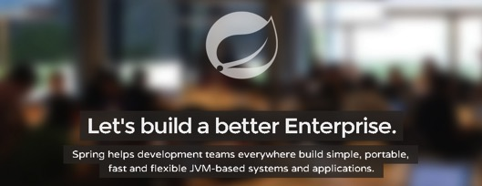
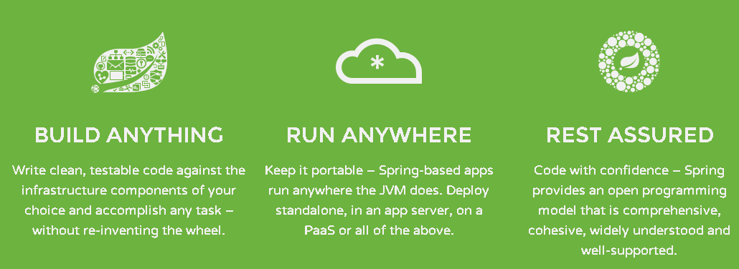
What is Spring IO?
the #1 enterprise Java application development framework
Embodiment of best industry dev practices
The best of Java OSS, curated & improved
OSS, Apache 2.0 licensed
Proven, mature, since 2004
Well understood and documented
Millions of downloads
Used heavily by Netflix and F2000
Notes:
Spring is an application framework and inversion of control container. More light weight and modular than JEE. Departure from JEE.
50% Java, 50% Spring
Spring is that lighter weight Java that began to erode the app server market in 2004, and helps straddle that world with the 3rd generation, cloud native platforms.
It even helps 2nd generation customers stuck on older versions of Java EE take advantage of newer Java EE features on their exact same server, often with an upgrade to their server.

Slide 4
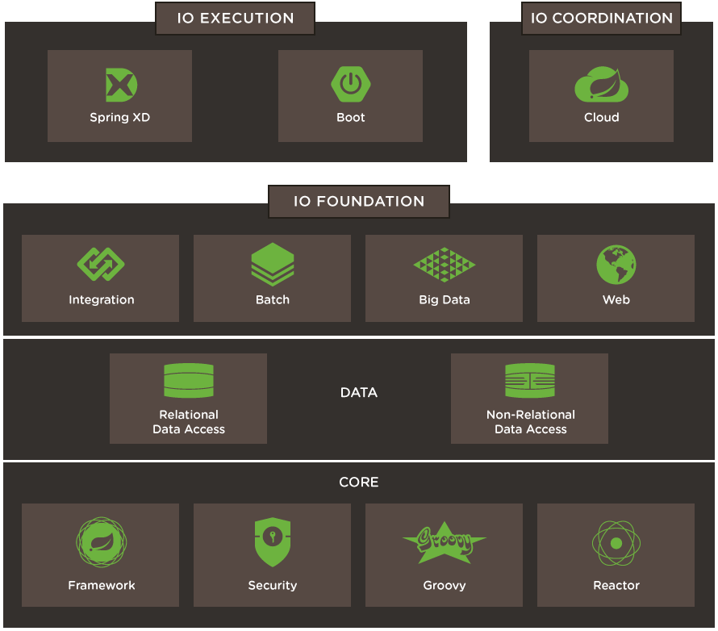

Slide 5
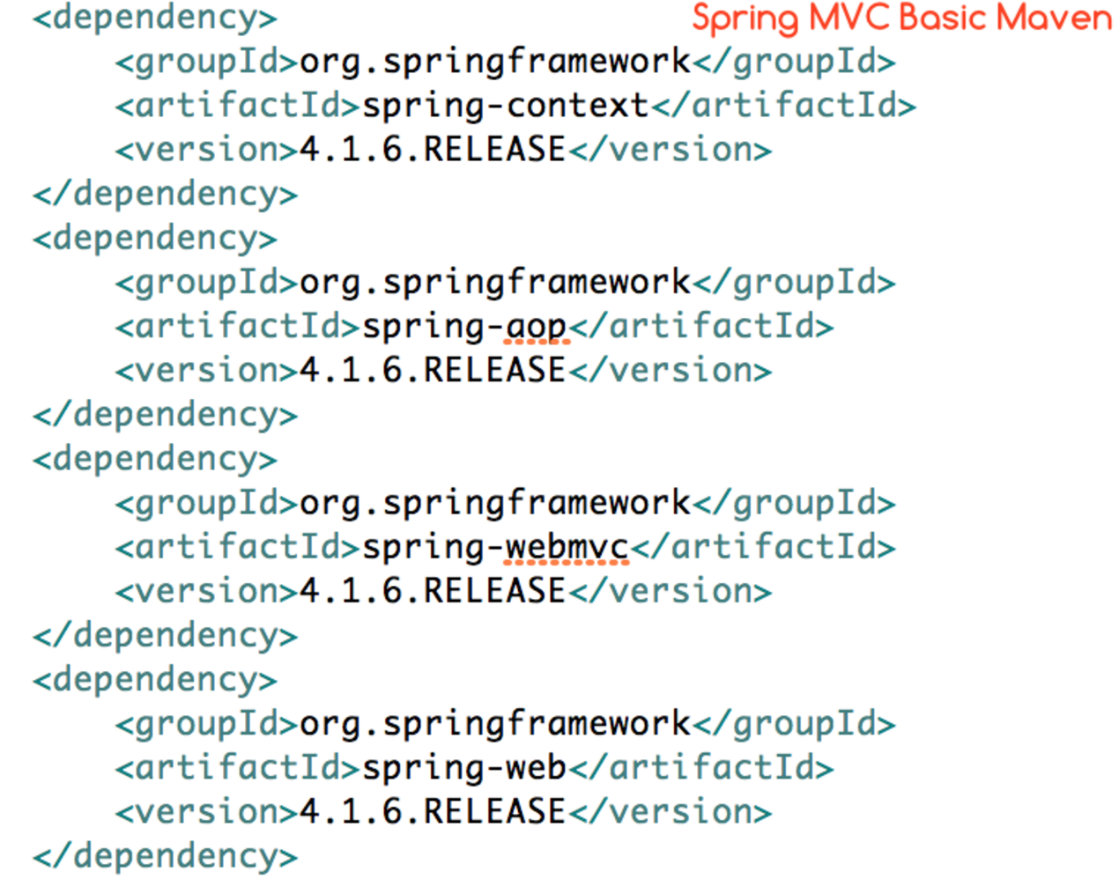
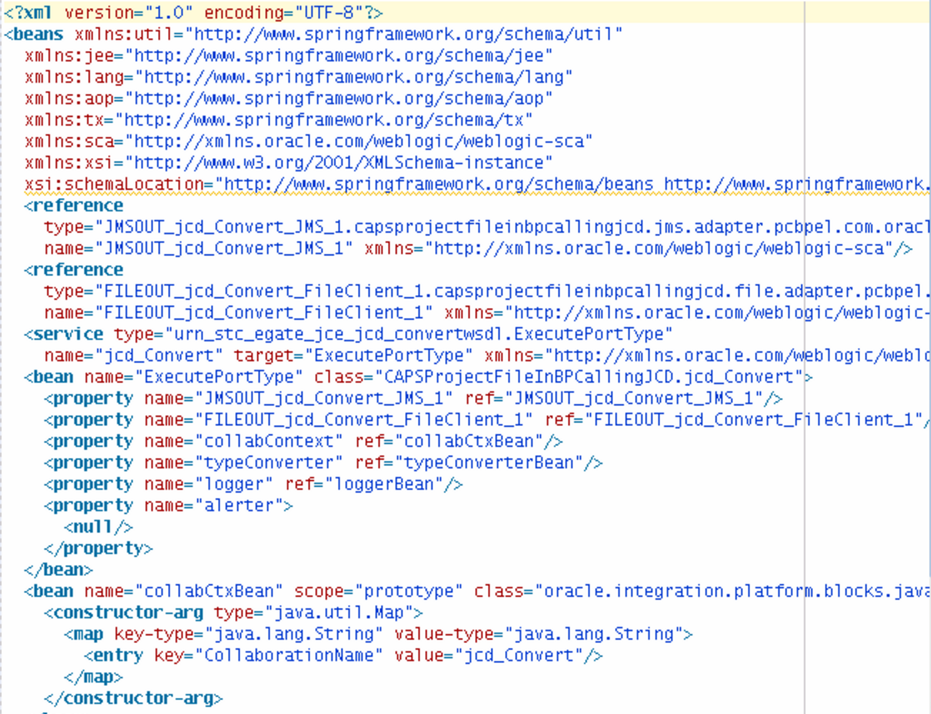
Challenges writing non-Boot applications
Notes:
Maven and Spring
Spring applications typically require a lot of setup
Consider working with JPA. You need:
Datasource, TransactionManager, EntityManagerFactory ...
Consider a web MVC app. You need:
WebApplicationInitializer / web.xml, ContextLoaderListener, DispatcherServlet, ...
An MVC app using JPA would need all of this
BUT: Much of this is predictable
Spring Boot can do most of this setup for you

Slide 6
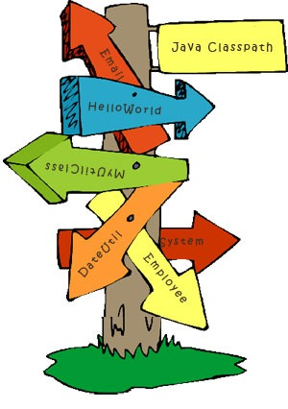
Challenges building non-Boot applications
Classpath errors
A Jar is missing
There is one Jar too many
A class is not visible where it should be

Slide 7
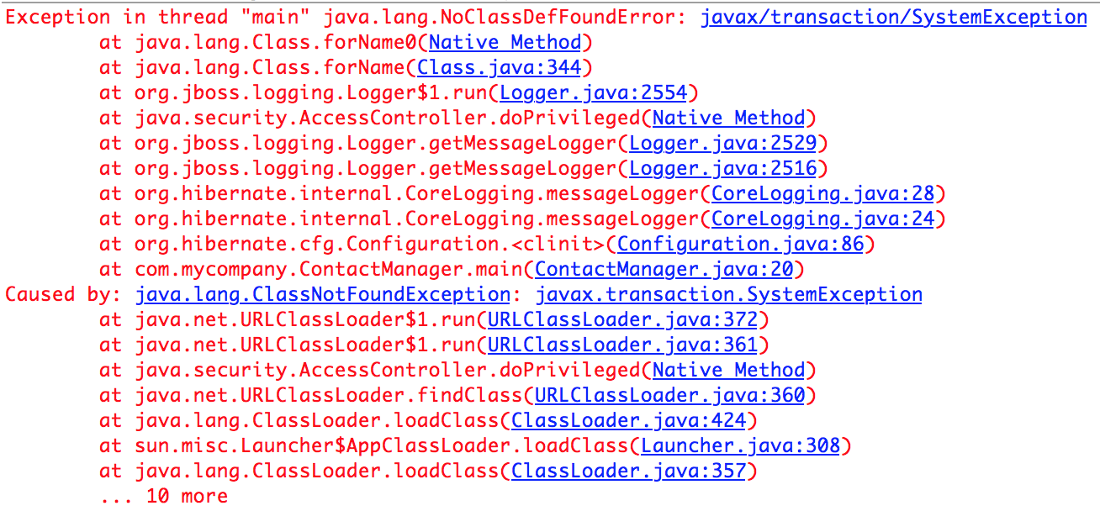
Challenges writing non-Boot applications
Version incompatibility of libraries

Slide 8
Challenges building non-Boot applications
Standard war/ear packaging causes drift across environments
war / ear
war / ear
App Server classpath
App Server classpath
Dev. Configuration
Prod. Configuration
Dev. Environment
Prod. Environment

Slide 9


Slide 10
What is Spring Boot?
An opinionated framework to simplify bootstrapping and development of new Spring Applications
Notes:
Convention over configuration.
Gets out of the way
An opinionated runtime for Spring Projects
Supports different project types, like Web and Batch
Handles most low-level, predictable setup for you
It is not:
A code generator
An IDE plugin

Slide 11
Spring Boot
Dynamic language productivity with maturity of enterprise Java
Cloud Native: Direct support for Microservices, NetflixOSS++
Fully automated app server configuration and deployment
Production ready Ops metrics out of the box, with a switch
Notes:
Why is boot so successful with developers? It doesn’t try to address concerns like reliability, availability, scalability, performance, and lets the platform it runs on handle it, focusing instead on developer productivity 100%. The Application Server technology of the last decade failed when trying to address these concerns at the Java container level, for internet scale.
Improvement in developer productivity: Boot has been created with a singular focus - Make developers productive, they focus on core business logic, Boot does all the rest of the heavy lifting. For ex: A dev can now write a robust database connected rest service in 10s of lines of code.
Ease of deployability: Spring Boot apps can be deployed in a few minutes with an embedded web runtime to lower the sprawl (and cost) of app servers.
So developers and operators both see benefits of building their apps on Spring Boot. 100% of Spring Boot codebase remains in the open source like all Spring projects.

Slide 12
Spring Boot Adoption
Monthly Maven downloads
3.66M
Source: oss.sonatype.org

Slide 13


D e m o
Notes:
Marketplace Walkthrough (if not done yet)
Network.pivotal.io walkthrough to show the services and how to download tiles as Operator

Slide 14


Slide 15
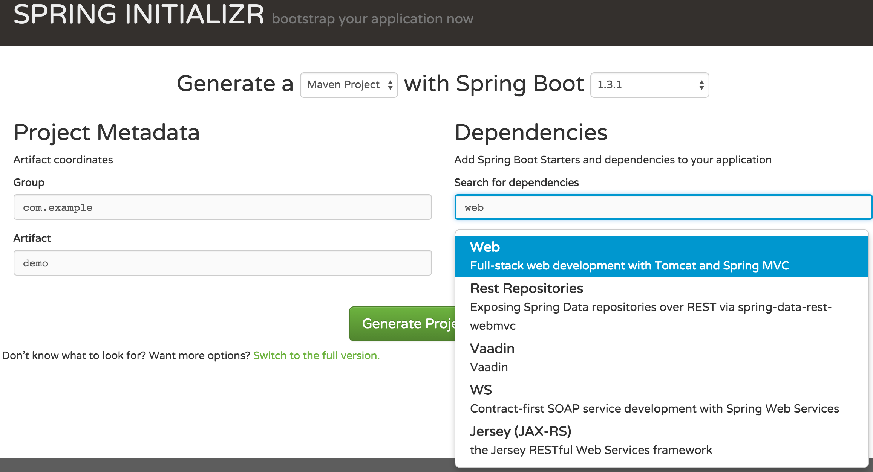

Slide 16
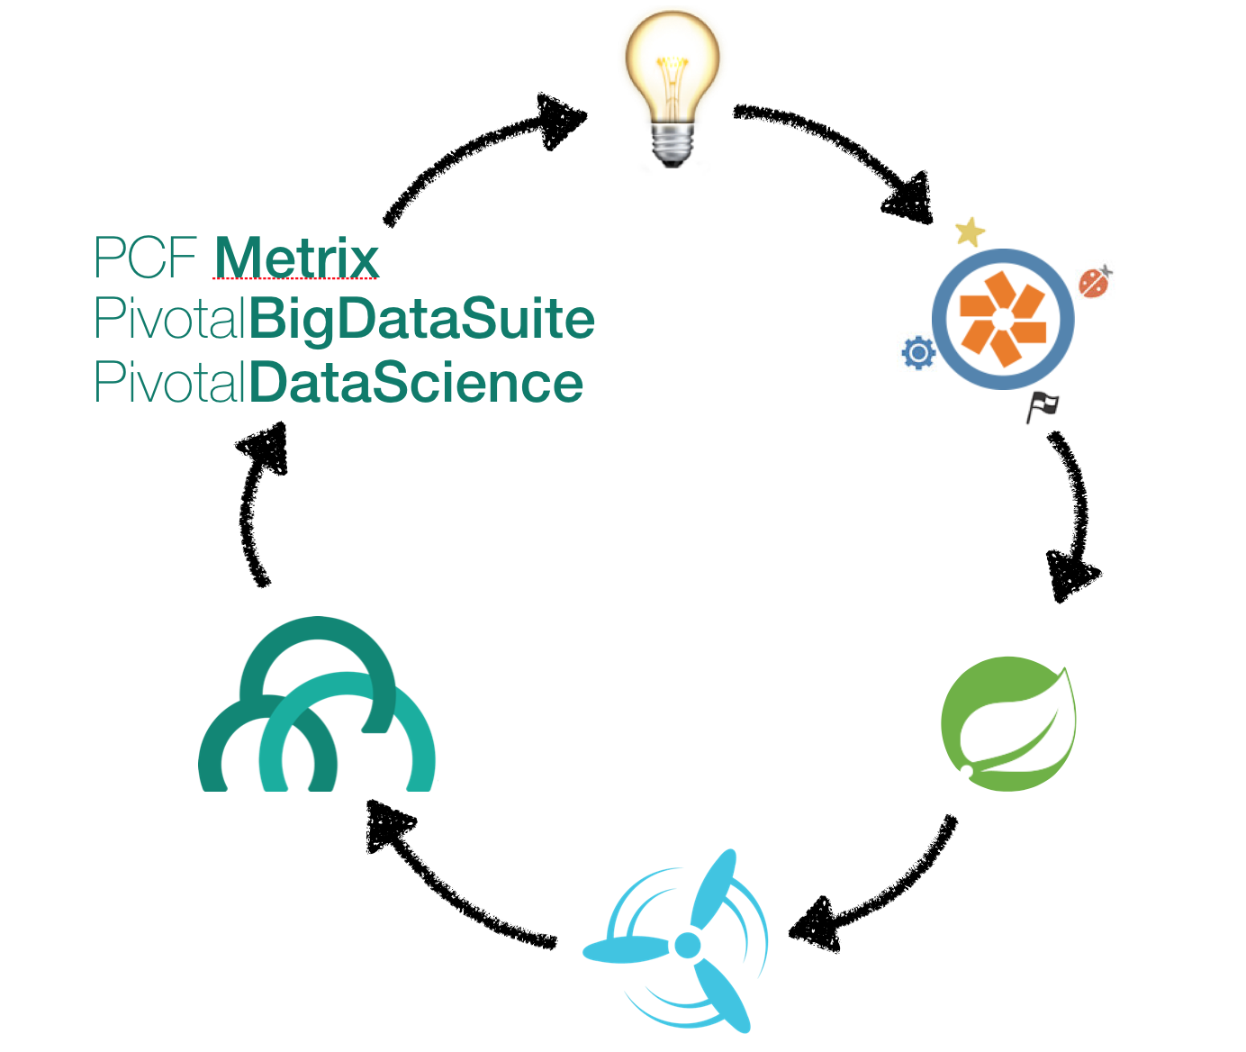

Slide 17
Further Reading
Initializr- http://start.spring.io
Spring.io- http://spring.io/spring-boot
HATEOAS- http://spring.io/spring-hateoas
Spring Data Rest- http://spring.io/spring-data-rest

Slide 18
Backup
Notes:
Marketplace Walkthrough (if not done yet)
Network.pivotal.io walkthrough to show the services and how to download tiles as Operator

Slide 19
Capabilities
Provides a consistent and easy way to a start project
Manages project dependencies
Packages deployable artifacts prevent configuration drift across environments
Provides conditional configuration across environments
Provides tools to improve developer productivity
Keeps you from writing explicit configuration
Exposes endpoints to manage and monitor applications in production

Slide 20
Spring Initializr
A configurable service to consistently and easily generate a quickstart project

Slide 21
Spring Initializr
Generates a Spring Boot project structure.
Provides a Maven/Gradle build specification.
Doesn’t generate application code.
You can customize the Spring Initialzr
https://github.com/spring-io/initializr/

Slide 22
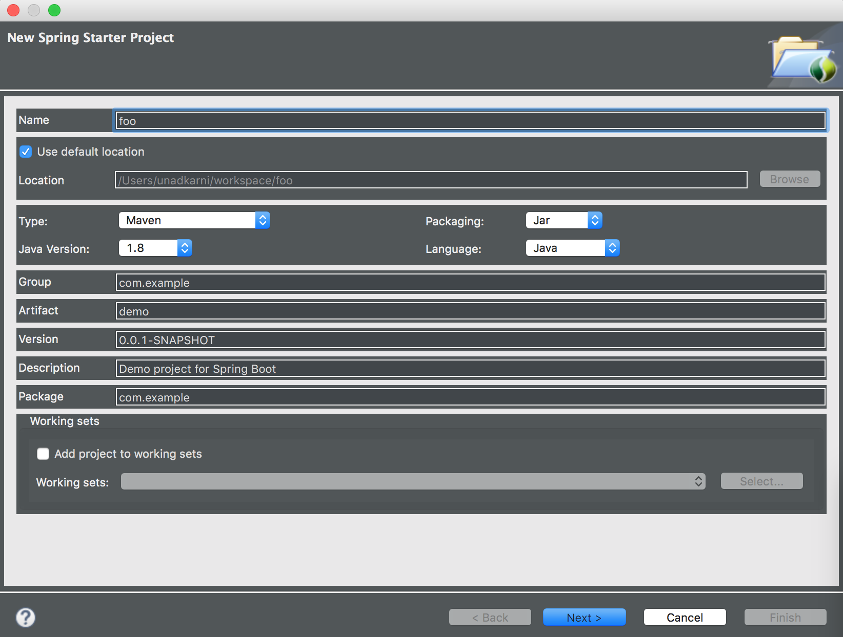
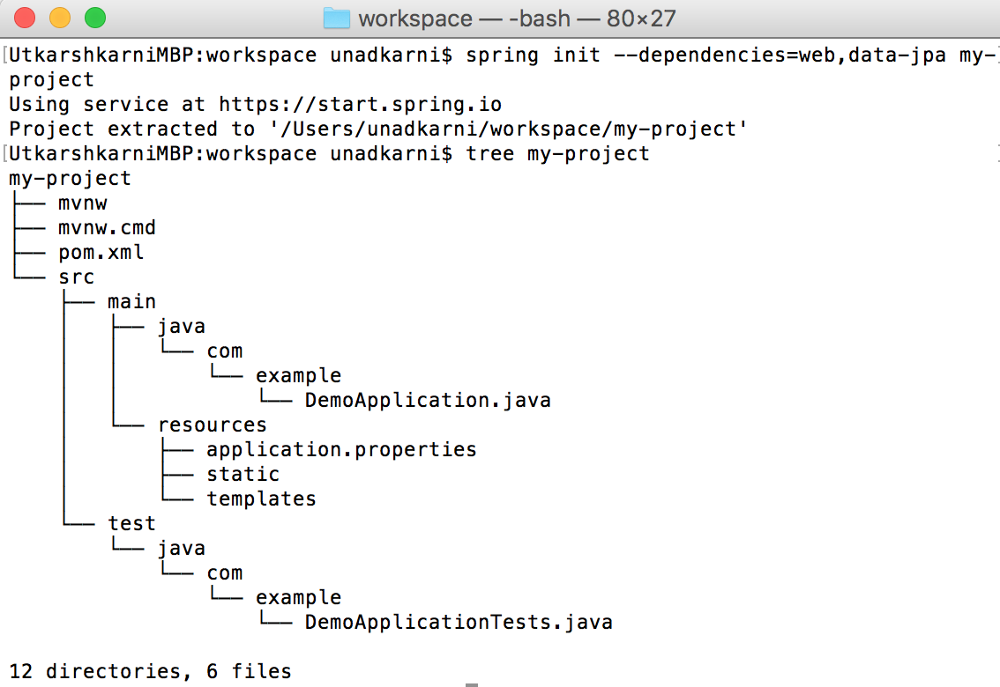
Supported Interfaces
IDE
Web-based interface
Spring Boot CLI

Slide 23
Spring Boot starters
Are virtual packages deployed to Maven central
They pull in other dependencies while containing no code of their own
spring-boot-starter-web
spring-web
spring-boot-starter-tomcat
spring-boot-starter-validation
spring-webmvc
jackson-databind

Slide 24
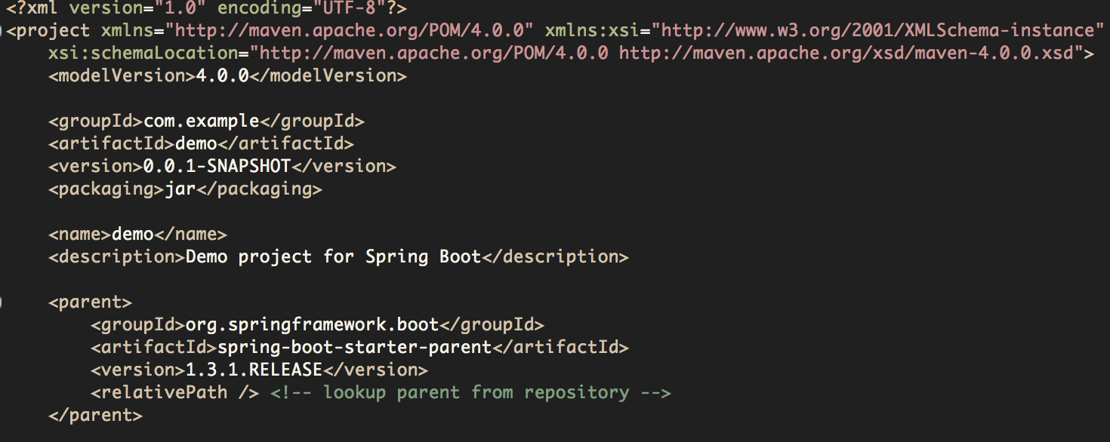
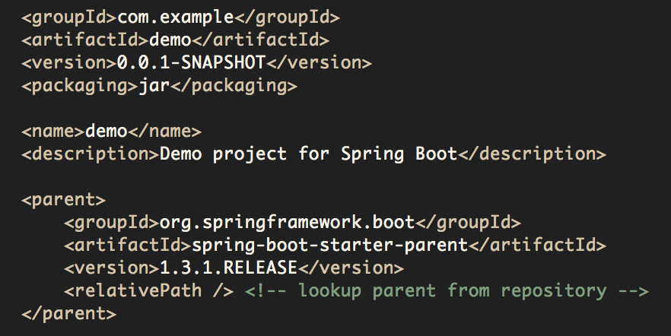
Project pom.xml
Set parent of your pom.xml as spring-boot-starter-parent
Inherit preset version numbers

Slide 25
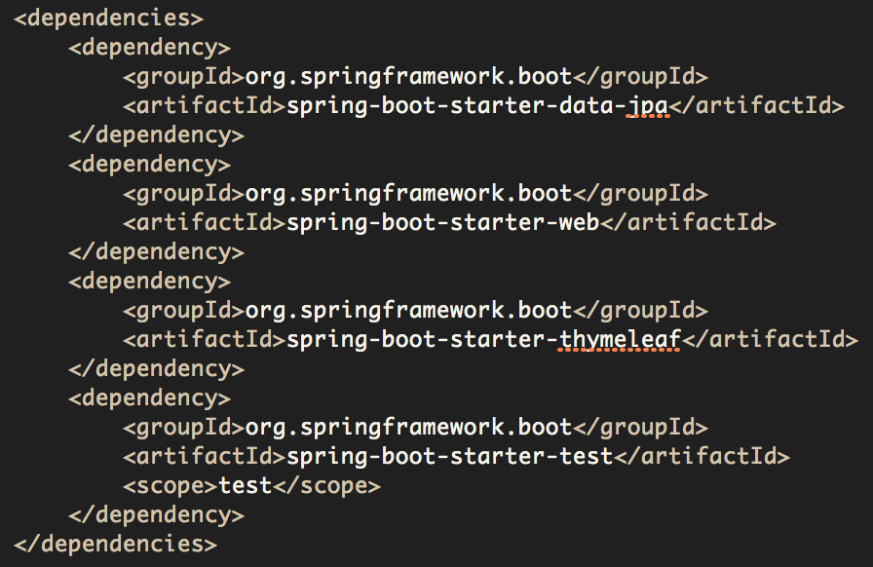
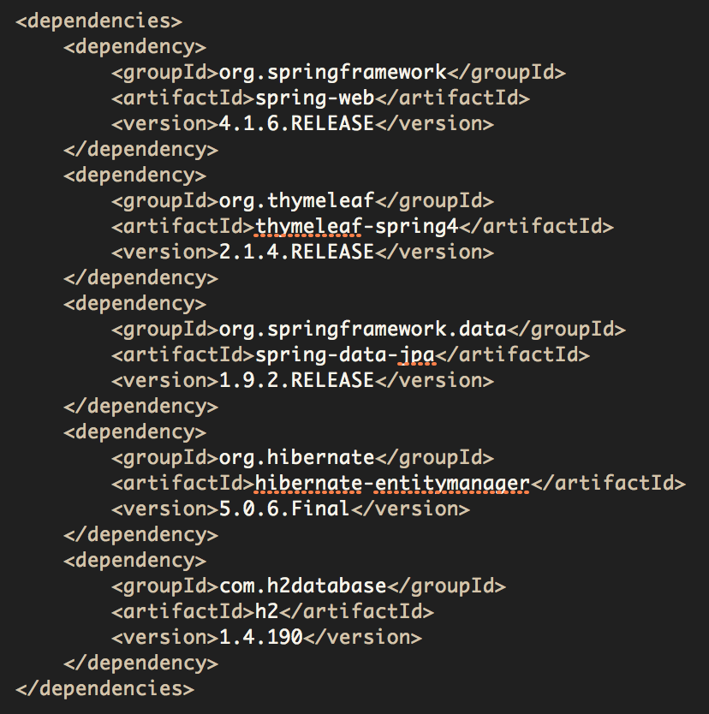
Starters vs Current Practice
Starter versions determined by version of Spring Boot used.
No explicit version numbers. Guaranteed to be compatible.
Are the version numbers compatible with each other?
Is the list of dependencies complete?
Concise. Boot pom.xml without version numbers.
Verbose. Non-boot pom.xml with version numbers.

Slide 26
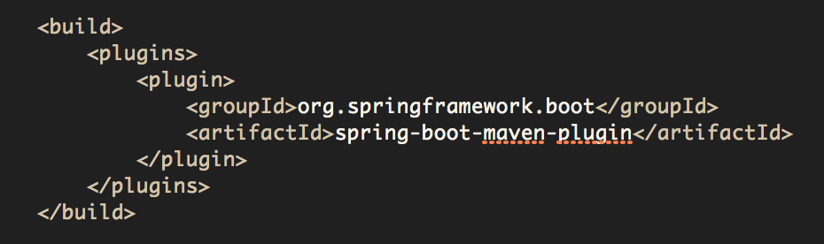



Packaging – Make Jar not War
Boot’s Maven / Gradle plugins produce an executable “fat jar”
Embedded Server
Application Code
Dependent Jars

Slide 27

Benefits of executable fat jars
No installation of application servers
No setting classpath
Promotes consistency across environments
Cloud-friendly
Can be started as Unix services using
init.d
systemd

Slide 28


Auto-Configuration
Automatically configures application based on the classpath
You have H2 in the classpath
You have Thymeleaf in the classpath
Application Context
H2 datasource
Jdbc
Template
template resolver
view resolver
template engine
You don’t have database connection beans configured manually
Let me auto-configure a Thymeleaf template resolver, view resolver, and template engine
Application Code
Let me auto-configure H2 datasource and JdbcTemplate
classpath

Slide 29
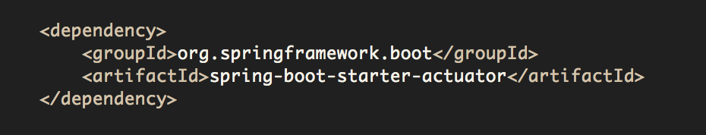
Actuator
Offers production-ready features such as monitoring and metrics to improve operator efficiency

Slide 30
Actuator
Services exposed through
HTTP endpoints for Spring MVC Applications
shell interface
JMX Beans
REST endpoint
shell interface
JMX
beans
Spring Boot Application
Actuator

Slide 31
Types of Actuator Endpoints
Actuator endpoints can be organized into three categories
Configuration
/beans
/autoconfig
/env
/configprops
/controller
Metrics
/metrics
/trace
/dump
Miscellaneous
/shutdown
/info

Slide 32
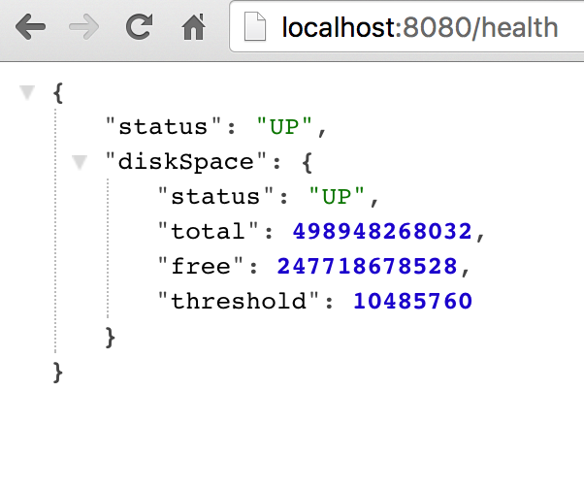
/health
Reports health metrics for the application
Each check returns a Health object
status
UP
DOWN
UNKONWN
OUT_OF_SERVICE
Possibly with details
Plugin own health definitions

Slide 33
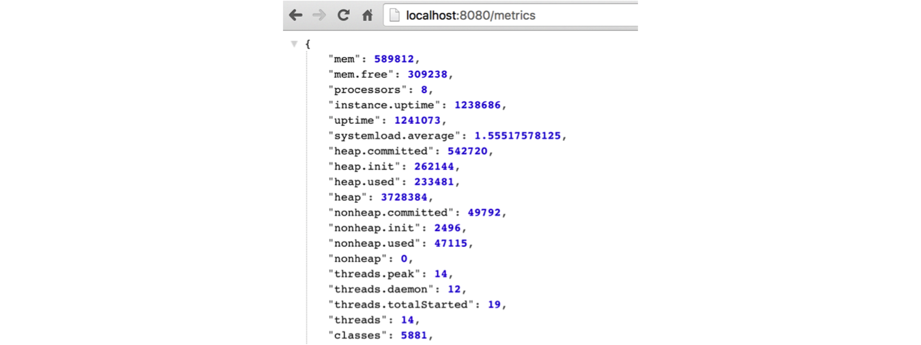
/metrics
Reports application metrics such as
Memory usage and
HTTP request counters

Slide 34

Spring Boot & Cloud Foundry

Slide 38
Further Reading
Initializr- http://start.spring.io
Spring.io- http://spring.io/spring-boot
HATEOAS- http://spring.io/spring-hateoas
Spring Data Rest- http://spring.io/spring-data-rest

